Slide 1
Git, github, and Docker
Developing Portable, Tracible, Reproducible Bioinformatic Pipelines

Slide 2
AGENDA
Please note that you are the first cohort taking this class. I will be working out the timing and pace of the material over the next 3 days. The agenda reflects what I think we can get done during the allotted class time will likely change as we progress. You may get out early, but I will not run over the scheduled time.

Slide 3
AGENDA Day 1
Overall Introduction
Pycharm Installation Check/Fix
What Is Version Control
Git
Git And Sourcetree Setup
Github ≠ Git Git ⊂ Github
Github Account Check/Setup
What Is Containerization?
​Intro To Docker​
Docker Installation Check/Fix

Slide 4
AGENDA Day 2
Python Type-hinting
Set Up A Central Repo For Our Work
Review Specs For Our RPS Project
Design Our Project And Split Into Teams
Start Our Project Container
Create Project Packages And Functions As Teams
Review Results And Set Version 1.0
Plan Version 2.0 Specs

Slide 5
AGENDA Day 3
How The Internet Works… Sort Of
Review Specs For Our RPSLS Project
Design Our Project And Split Into Teams
Make Updates To Our Requirements And Container
Create Project Packages And Functions As Teams
Review Results And Set Version 2.0
Talk About Other Potential Extensions

Slide 6
Introduction
Bioinformatics applications have become more and more complex and dependent on computing environments. The need to be able to track changes over time, replicate computing environments, and collaborate across sites and even geographic areas has never been stronger.
Some estimates hold that about half of all bioinformatic software packages published are functionally not deployable by a user of typical experience levels due to undocumented dependencies in the environment or other sub-optimal practices.
Let’s end having to hear people say, “I don’t get it, it worked fine on my computer.”

Slide 7
IDE
Integrated Development Environment
PyCharm by JetBrains

Slide 8
Why pycharm?
Widely-agreed to be one of the most feature-rich IDEs for Python
VSCode is a close competitor
Excellent support for type-hinting, code completion, error detection, web development, debugging, and many other critical functions
The best and easiest support for containerized development of any IDE I have seen
Available in a community (free) or professional (paid) edition
Educational licensing provides a free version of the professional edition
https://www.jetbrains.com/community/education/
Please open up your copy to ensure that it is installed and working. If you do not have a copy, please use the above link to sign up for the educational program (suggest using your .edu email address for this) and get a copy to install.

Slide 9
VCS
What is a Version Control System

Slide 10
What is a version Control System?
A system to track changes to files over time
Likely to have the following features
Revert changes in a file to a previous state
Revert the entire project to a previous state
Identify the original source as well as the source of any changes to a section of a file
Document the nature of and reason for a set of changes to the files
May have the following features
Allow for collaboration between individuals
Maintain a central server for the project files

Slide 11
Types of vcs
Local
Potentially as simple as moving to a new directory or creating new files with increasing version numbers (myCode.v1.2.1.py)
Prone to errors
Prone to data loss
May use diff or equivalent to track differences in version
Hinders collaboration more than it helps in most cases
Not designed for teams, so conflicts are absent
Example: RCS or your local file system
Generally considered out of line with modern practices

Slide 12
Types of VCS
Centralized
Always hosted on a remote server
Can cause data loss if the central server fails
Users check out a file, perform their modifications, check modified file back in
Files are locked while the user has it checked out
Conflict avoiding
This can be a problem when Kevin checks out a file on Friday before his week long vacation and forgets to check it back in
Why is it always Kevin?
Designed for collaboration within a team
Examples: CVS, SVN

Slide 13
Types of VCS
Distributed
Everybody has a complete copy of the code at all times
Resilient against data loss
Allows wide-spread collaboration among several teams
Remote server generally handles the centralized version, but local-only development is possible
Individual copies and files are tracked for where they are relative to the current centralized system state
Changes are checkpointed by “committing” them
Conflicts may arise and are resolved when “merging” a set of changes to the central repository
Example: Git

Slide 14
Git: What and why
Invented by the creator of Linux to handle the large, world-wide community simultaneously developing many parts of the system
Focused on snapshots of file state
Called commits
Most work is done locally
Everyone has a copy of everything
Files exist in 1 of 4 states
Unmodified (no changes)
Modified (changes)
Staged (changes set to be included in the next commit)
Committed (commit executed, changes added)
Support for non-linear development
Branching!

Slide 15
GIT: How
Clone
Pull a copy of the central repository to the local system and start tracking changes locally
Branch
Optional, but usually a good idea before making modifications
Modify
Add, remove, or change files
Commit
Snapshot a set of changes
Fetch/Pull
Examine changes on central repo since last pull (fetch), or add changes from central repo to current branch (pull) to avoid and resolve any conflicting changes
Push
Send branch and current set of commits to central repo so it becomes a branch on the central system
Merge
Add changes on the branch to a parent branch

Slide 16
Installing git
Installing Git on your local system depends upon OS
If you have not yet installed it, please search for instructions on how to install it on your local operating system
Git itself is a command line tool, but remembering all commands and their formatting is difficult
Download from https://www.sourcetreeapp.com/ for Mac or Windows
Please have a terminal showing Git up as well as Source Tree open

Slide 17
Github
A website functioning as the central repository with many added features.

Slide 18
Github
Is not Git, but is able to run all or nearly all Git functions
Provides a publicly accessible website for easy sharing of code
Adds traceability beyond Git
Pull requests provide additional documentation of contributed code being added or rejected
Supports a global community working on a major project
Please pull up Github to show that you are logged in.

Slide 19
docker
The Most Popular Containerization Solution

Slide 20
Is a container a VM?
They are similar in many ways, but have some major fundamental differences
VMs are more isolated and have more strictly-defined resources
A VM can be assigned 2 cores and 8gb of RAM and it will hold those resources when idle or when running at max capacity
A container can use all (or nearly all) available cores and RAM if not limited
A container is like running an entire OS with build-in instructions as its own program
A VM is like running a separate machine

Slide 21
Parts to docker
Images
Docker images form the starting point for each container and are made from a dockerfile
Container
Docker image put into action. Should be running an application or service if active
Docker Engine
The system that builds images and runs containers and controls commiunication between them
Registry
Cloud or server based storage system for getting images

Slide 22
Docker commands
docker image pull python:3.11
Fetches the python 3.11 image from the configured registry
docker image ls
Lists available local images
docker search python
Search container registry for python images
docker image build -t mycontainer:latest .
Builds a new container called mycontainer using the current working directory as a build context

Slide 23
Docker commands
docker container run python:3.11
Runs a new container built from the python 3.11 image
docker container run -d -p 5000:5000 --name tester python:3.11
Similar to above, but will run the container in the background, open up port 5000 for communication, and specifies the name of the container
docker container stop tester
Stops the above container
docker container rm tester
Deletes the above container

Slide 24
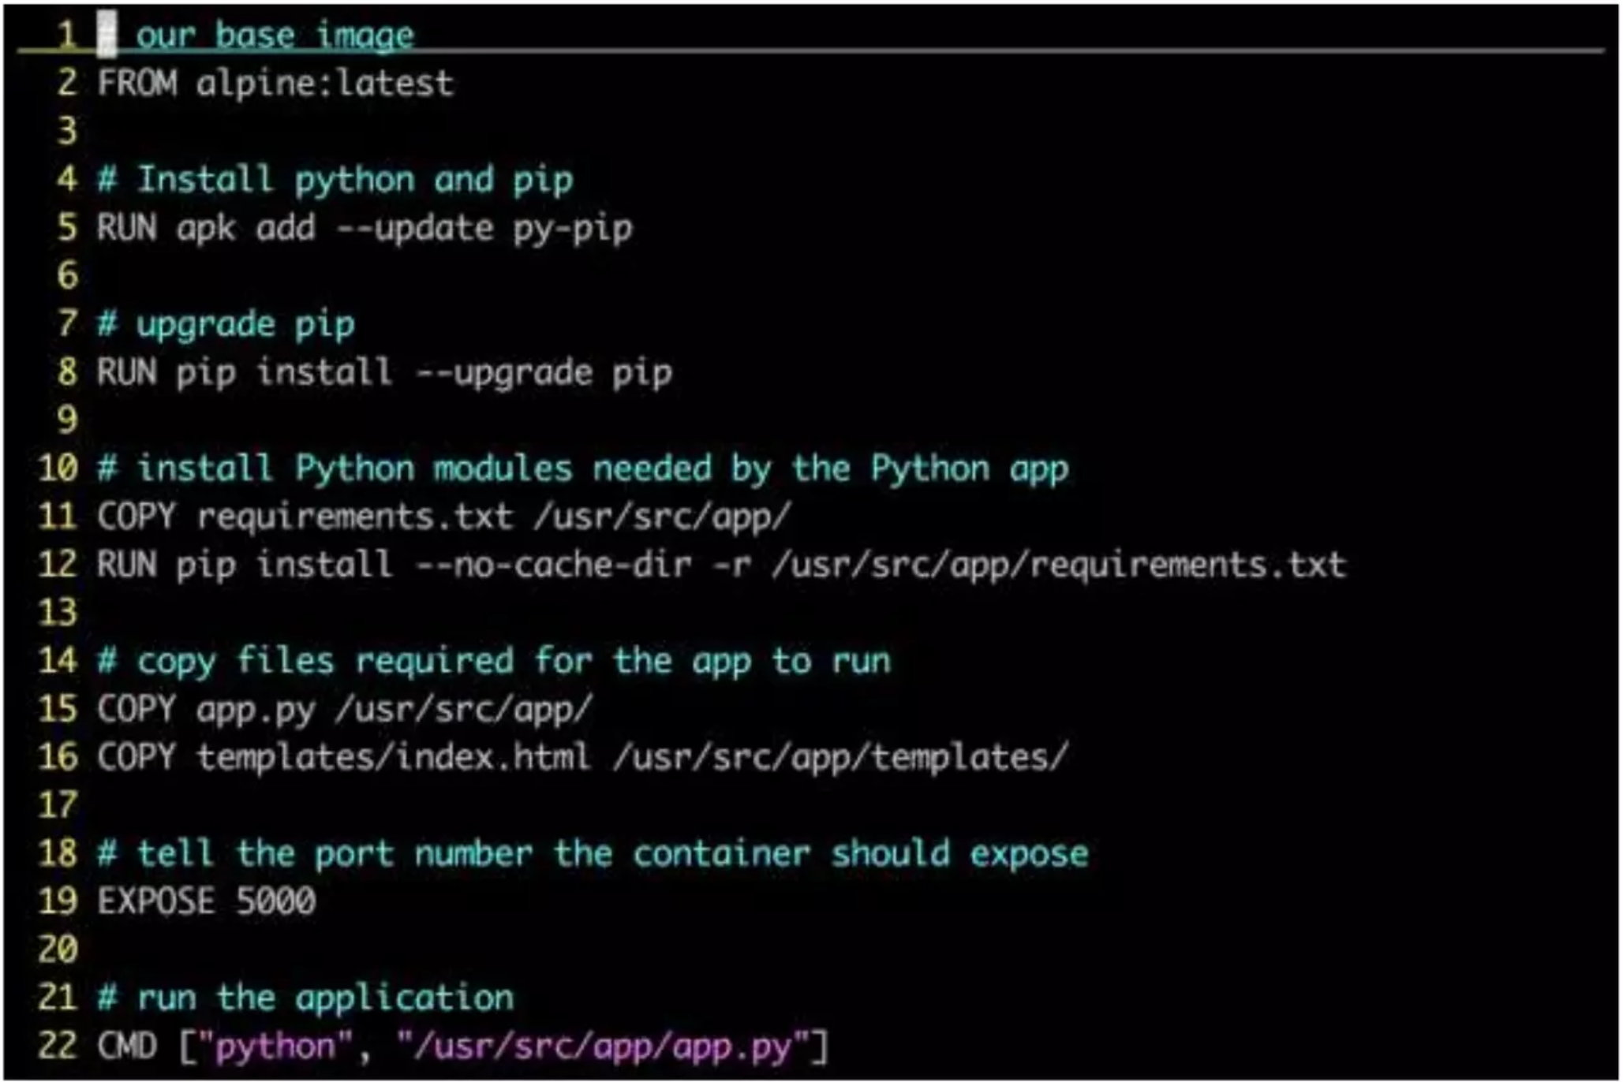
The dockerfile
Set of instructions to build an image
Looks similar to native OS commands
Builds are layered to avoid duplicated effort
Clear optimization strategies

Slide 25
Checking docker installation
Run the following command in a terminal
docker container run hello-world

Slide 26
SUMMARY
At this point, your system should be prepared to do more modern development in a collaborative environment with resources to ensure that the environment is reproduced and tracked.

Slide 27
THANK YOU
Tomorrow we will start developing our Rock, Paper, Scissors app as a team.

